Slide 1

Computer Architecture
Keivan Navi
Cal Poly Pomona University
knavi@cpp.edu
Office hours: Tu/Th 5:25 Pm to 6:55 Pm
Office: 8-49

Slide 2
Computer Architecture
HA+ HA- HA–
Full Adder--

Slide 3
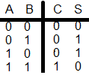
Half Adder
Half Adder (recall):
A Half Adder is a circuit that takes two inputs, A and B, and produces two outputs, S (the sum of A and B) and C out (the carry out). It uses an XOR gate and an AND gate to perform the addition. However, unlike a full adder, it does not have an input for the carry out from the previous column.
The Truth table of HA follows:
C (Cout or Carry or Carry out)=AB
S (Sum) = AB’ + A’B = A XOR B

Slide 4
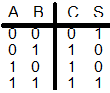
Half Adder Plus (HA+)
Half Adder Plus:
A Half Adder Plus is a circuit that takes two inputs, A and B, and produces two outputs. The result is the addition of A ,B and 1 (A + B+1). It uses an XNOR gate and an OR gate to perform the addition. Adding 1 to the sum of A and B is done by default.
The Truth table of HA+ follows:
C = A + B
S= AB +A’B’ =A XNOR B

Slide 5
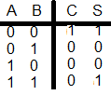
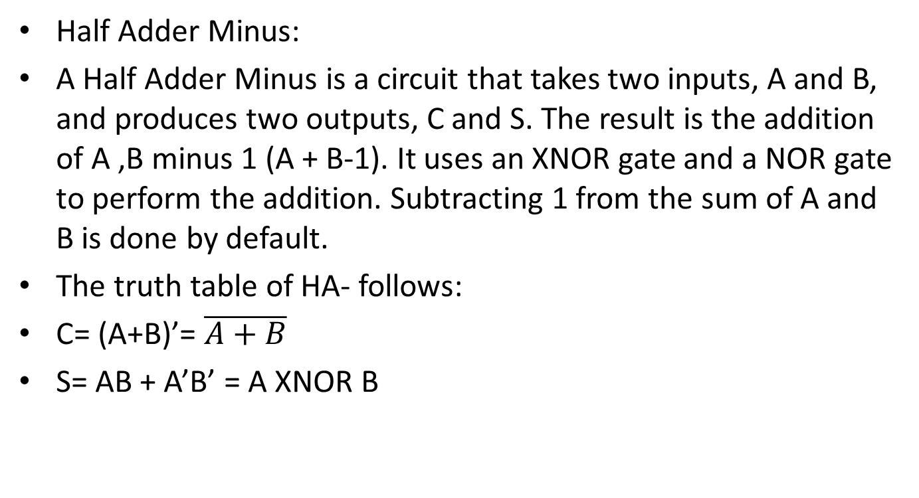
Half Adder Minus (HA-)
Half Adder Minus:
A Half Adder Minus is a circuit that takes two inputs, A and B, and produces two outputs, C and S. The result is the addition of A ,B minus 1 (A + B-1). It uses an XNOR gate and a NOR gate to perform the addition. Subtracting 1 from the sum of A and B is done by default.
The truth table of HA- follows:
C= (A+B)’= $\overline{A+B}$
S= AB + A’B’ = A XNOR B

Slide 6
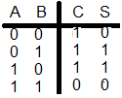
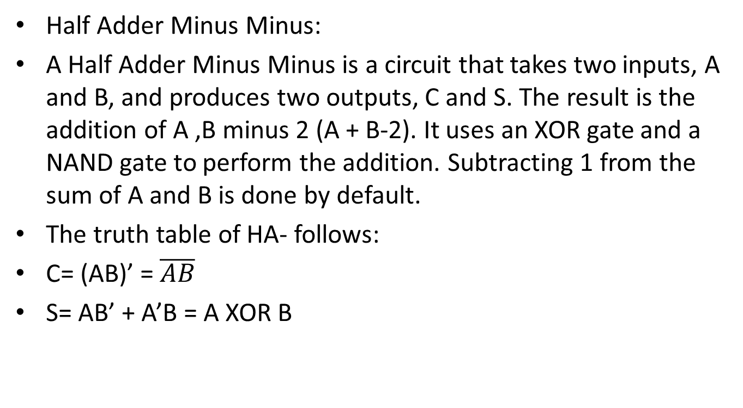
Half Adder Minus Minus (HA- -)
Half Adder Minus Minus:
A Half Adder Minus Minus is a circuit that takes two inputs, A and B, and produces two outputs, C and S. The result is the addition of A ,B minus 2 (A + B-2). It uses an XOR gate and a NAND gate to perform the addition. Subtracting 1 from the sum of A and B is done by default.
The truth table of HA- follows:
C= (AB)’ = $\overline{AB}$
S= AB’ + A’B = A XOR B

Slide 7
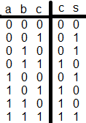
Full Adder
Full Adder (recall):
Full Adder is the circuit that adds three inputs and produces two outputs. The first two inputs are A and B and the third input is an input carry as C-IN. The output carry is designated as C-OUT and the normal output is designated as S which is SUM.
The truth table of Full adder follows:
C= AB+AC+BC= Majority Gate
S= A XOR B XOR C= A’B’C + A’BC’+ AB’C’ + ABC

Slide 8
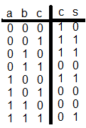
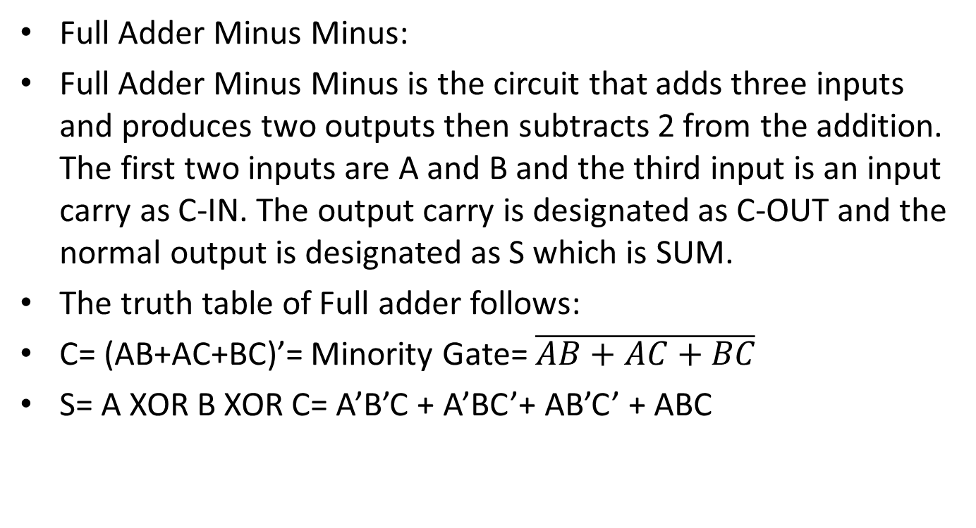
Full Adder Minus Minus
Full Adder Minus Minus:
Full Adder Minus Minus is the circuit that adds three inputs and produces two outputs then subtracts 2 from the addition. The first two inputs are A and B and the third input is an input carry as C-IN. The output carry is designated as C-OUT and the normal output is designated as S which is SUM.
The truth table of Full adder follows:
C= (AB+AC+BC)’= Minority Gate= $\overline{AB+AC+BC}$
S= A XOR B XOR C= A’B’C + A’BC’+ AB’C’ + ABC

